Slide 1

Why Does Application Security Take So Long?
Metricon X, 2019
Chris Eng
Vice President, Research
Jay Jacobs
Chief Data Scientist

Slide 2
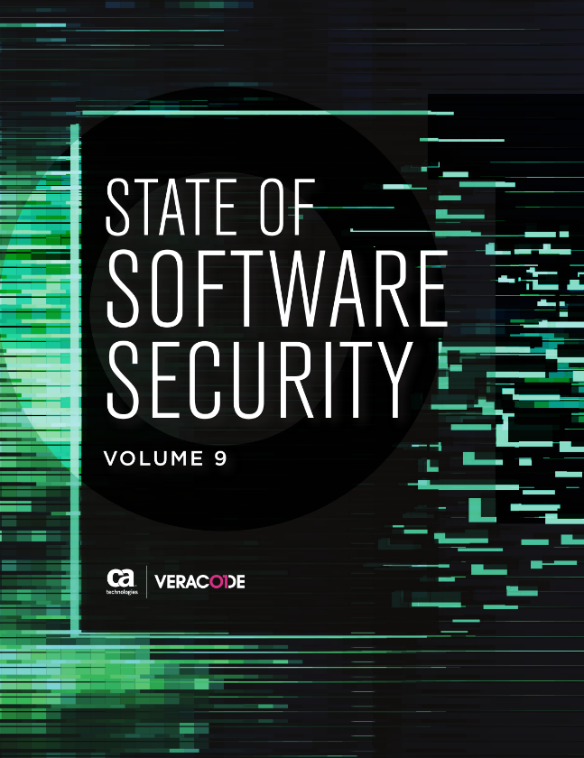
What is This Research?
Veracode State of Software Security (SoSS), Volume 9
Largest quantitative study of application security findings
Partnered with Cyentia Institute to analyze the data set

Slide 3
Why and How?
Why
Gain insight into real-world application security practices (i.e. not a survey)
Provide data for customers to benchmark themselves against their peers
Generate actionable advice for improving application security programs
How
Formulate a list of questions that might be answerable given the available data
Stand back and use science
Notes:
This note may belong to a different slide? “Single Scan Apps” have an age of 0 and are still open (scanned once)

Slide 4
Data Sources
Veracode customers
12 months of application scan data
April 1, 2017 – March 31, 2018
Over 700,000 application assessments representing 2 trillion lines of code
Started with about 24 million findings
All open flaws retained “discovered” date
Variety of orgs, industries, languages, purposes (open source / proprietary)

Slide 5
Key Takeaways
85% of applications had at least one finding
About 13% have at least one critical severity flaw
More than 70% of all flaws remain 1 month after discovery
Nearly 55% remain 3 months after discovery
1 in 4 high and very high severity flaws are still open after 290 days
The most active DevSecOps programs fix flaws more than 11.5x faster than the typical organization

Slide 6
The Big Picture

Slide 7
Filtering and Cleaning
Removed sandbox scans (11m)
Removed dynamic scans (1.2m)
Removed single-scan apps (3.4m)
Removed “mass-closure” events (2m)
Ended up with about 6.3 million findings
Notes:
“Single Scan Apps” have an age of 0 and are still open (scanned once)

Slide 8
“Mass-Closures”

Slide 9
“Mass-Closures”
14k closed on day 7 (18%)
10k closed on
day 7 (12%)
52k findings
Notes:
Common causes
SAST: modules removed
DAST: cannot reproduce

Slide 10
Closures per Event

Slide 11
Closures per Event

Slide 12
Closures per Event

Slide 13
“Mass-Closures”

Slide 14
“Mass-Closures”

Slide 15
Survival Analysis
Studies duration / time to event
Has a lot of other names
Accounts for censored data (participation, but no event recorded):
Team stopped scanning an application
Finding still open at time data collected
Notes:
Sociology: “event-history analysis”, engineering: “failure-time analysis”

Slide 16
Survival Analysis
“Censored”
data

Slide 17
Survival Analysis

Slide 18
Survival Analysis

Slide 19
Survival Analysis

Slide 20
Survival Analysis

Slide 21
Which Factors Influence Remediation?
Notes:
Coxph model, R2 = 0.011 for “severity + exploitability + app_crit”

Slide 22
Severity of Finding

Slide 23
Severity of Finding

Slide 24
Severity of Finding

Slide 25
Exploitability of Finding

Slide 26
Severity + Exploitability of Finding

Slide 27
Business Criticality of Application

Slide 28
Severity + Criticality

Slide 29
DevSecOps
Notes:
Coxph model, R2 = 0.011 for “severity + exploitability + app_crit”

Slide 30
Scan Frequency
Notes:
To keep things in perspective, when we look at scan frequency by application, we see that it’s still heavily weighted toward just a handful of scans per application. The median scan rate amongst our entire application portfolio under test is still just two.
What does this tell us? Plenty of organizations obviously still stick to what they’ve always done before.

Slide 31
Scan Frequency

Slide 32
Scan Frequency

Slide 33
Scan Frequency

Slide 34
Scan Frequency

Slide 35
An Unanswered Question

Slide 36
The challenge of interval data

Slide 37
The challenge of “n = ?”
Notes:
Note: we don’t have an answer for this, (yet)

Slide 38
The challenge of “n = ?”

Slide 39
The challenge of “n = ?”
Notes:
At a sample of 8.9k, that’s +/- 0.9% or so

Slide 40
The challenge of “n = ?”
52 orgs / 84 apps
232 / 485
415 / 1653
999 / 7478
Notes:
app_latest_language org apps
1 Python 52 84
2 iOS 103 216
3 C++ 118 432
4 PHP 214 519
5 Android 232 485
6 Javascript 415 1653
7 Java 759 8899
8 .Net 999 7478

Slide 41
Future Ideas
Reconfirm scan frequency findings on next year’s data set
Incorporate findings from other products
Greenlight (i.e. IDE-based partial scans)
SourceClear-based SCA findings
Longer term: correlation of findings to individual developer activity

Slide 42
Future Ideas (Jay?)
(fragment I clipped from an email thread: “A note for future data collection is to generate/store some type of scan_id that gets tied to the finding, so joining scans to findings is failsafe”)
This seemed maybe worth mentioning but I don’t quite get it

Slide 43
Why Does Application Security Take So Long?
Metricon X, 2019
Chris Eng
Vice President, Research
Jay Jacobs
Chief Data Scientist

Slide 44
By Industry

Slide 45
(Chris) - 5
History, methodology, data set
Motivations for the study, wanting to answer all sorts of questions (give some examples, including some we can't answer with the data set)
High level exec summary (maybe)
(Jay) – 5
Decisions about anomalies in the data set (see Jay's email from 8/28)
· Policy (no sandbox) + Static + !singles + !mass_closures
· On mass closures: DynamicDS scan that get labeled as "cannot reproduce" and static scan events with modules removed; decision to drop top 0.1% of closure counts, i.e. 2000+ in a single day
(Chris) – 1
Introduce the topic of remediation, why we wanted to find out more, etc.
· Maybe nix this transition and just have Jay introduce it
(Jay) - 8-10
Deep dive on survival analysis -- a few slides
· Mention proportional hazard model as a lead into the next set of findings
· Describe the components of the new visualization and decisions around the design
(Chris) - 8-10
Trying to figure out correlations between factors we measure and remediation rates; go through all the items we looked at
· Severity
· Exploitability
· Severity + Exploitability
· App Criticality
· App Criticality + Severity
· …and finally, Scan Frequency
Scan frequency findings
· Frequency as a proxy for DevOps
· The scan frequency plots
· Broken assumptions about scan spacing (the 1x-12x time series plots)
(Jay) - 5-10
Other interesting commentary on the analysis
· Emphasis on n-values and what does "sample size" mean
o You may have a million findings but only 100 companies
o How does this tie to confidence intervals
o Abstracting from flaws, or apps, or companies
· TBD: check the exploratory analysis
(Both) – 5
Chris wrap-up
· Reiterate most important finding(s)
· TBD: Things we'd like to do differently, build on, reconfirm, etc. next time
Jay wrap-up
· TBD

